Slide 1


Slide 2
What is Smart Security system.
Usually People prefer to buy door sensor to detect if someone is outside or door locks that can be monitored and potentially controlled from one’s selfphone.
In essence, smart alarm systems may be able to empower the customer to build their own network security while retaining control, usually thorough their cell phone

Slide 3
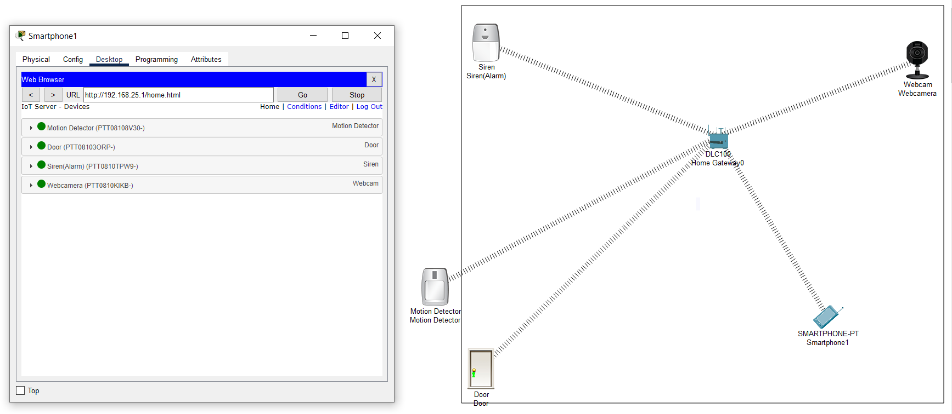
Implementation the commands

Slide 4
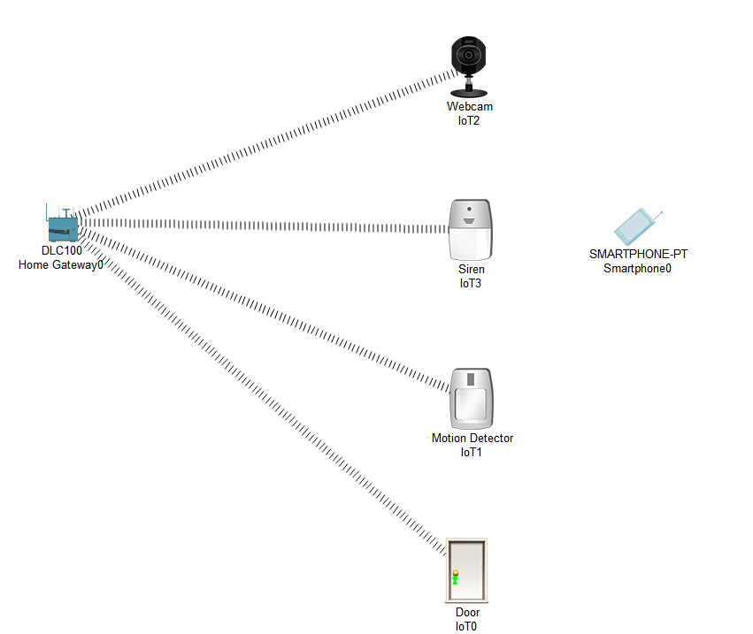
Components used

Slide 5
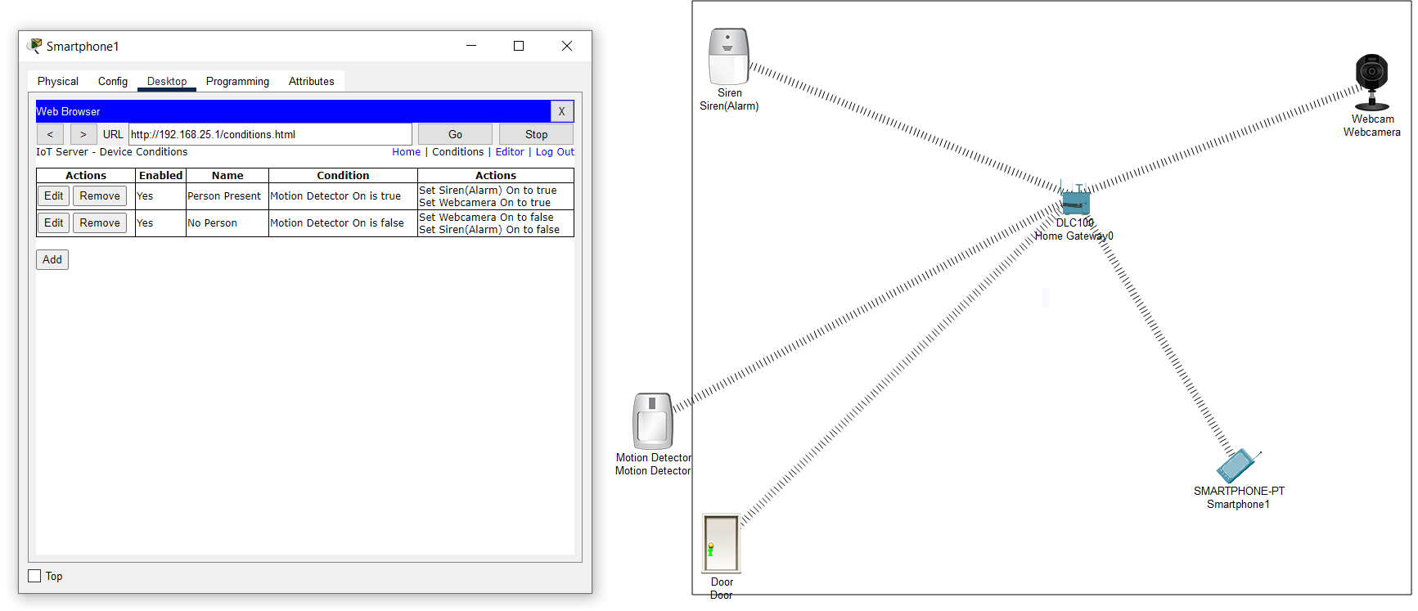
Commands Given

Slide 6
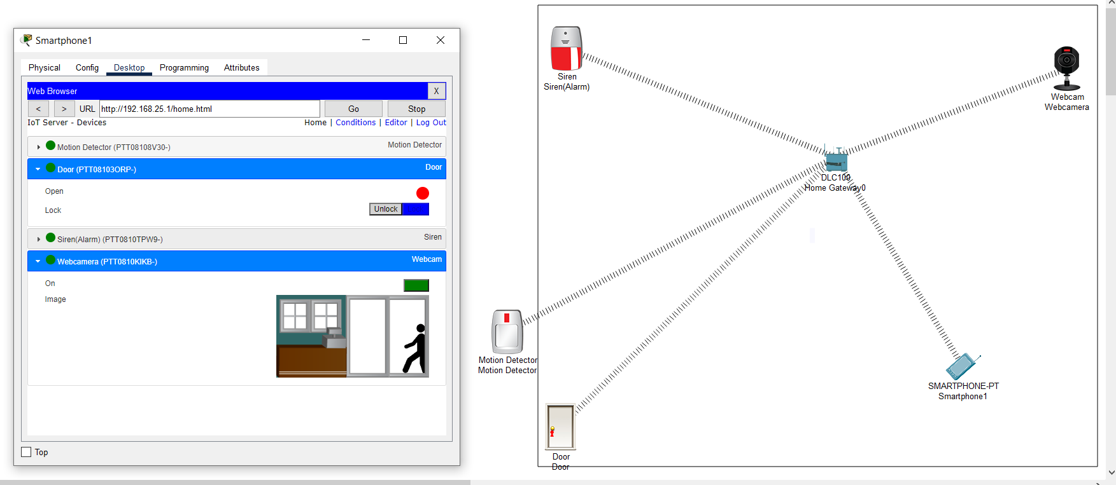
Simulation of scenior

Slide 7
Conclusion:- WHERE WE CAN IDETIFY WHO TRIES TO ENTER YOUR RESTRICTED AREA AND GIVES YOU THE FLEXIBILITY TO HAVE THE CONTROL OF PERMITTING THEM IN OR NOT

Slide 8
Thanks For Being a part of the mini project

